Slide 1
Presentation on Glass Classification
Ri
By:
Pranisha Maharjan
Na
Mg
Al
Si
K
Ca
Ba
Fe

Slide 2
Objectives
Db
Sg
Ce
Pr
Nd
Nd
Th
Pa
U

Slide 3
Introduction
Mg
The classification of glass is based on several factors, including its chemical composition, manufacturing process, and intended use.
since glasses are used in various industries to manufacture different types of items, identifying the type beforehand from its components (oxide content) can save cost, time and effort.
Ca
Sc
Rb
Sr
Y
Zr
Cs
Ba
La
Hf
Fr
Ra
Ac

Slide 4
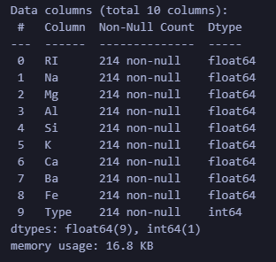
Dataset Information
10 columns of numeric type
RI
Na
Mg
Al
Si
K
Ca
Ba
Fe
Type
RI is an index variable and has no units. Columns 3-9 are measured as weight percent in corresponding oxide.

Slide 5
EDA Performed in Data Analysis
Print top five records in the dataset
(data.head())
Check the statistical information and distribution of the data
(data.describe())
Counting the number of missing values in the dataset
(data.isnull().sum())
Bh
Hs
Pr
Nd
Nd
Sm
Th
Pa
U
Np

Slide 6
Ce
Pr
Nd
pass a 2D data set or a pandas dataframe.
(sns.heatmap(data.corr(),annot=True, cmap="Blues"))

Slide 7
Rg
Cn
Nh
Fl

Slide 8
Mg
Ca
Sc
Sr
Y
Zr
Ba
La
Hf
Ac
Rf

Slide 9
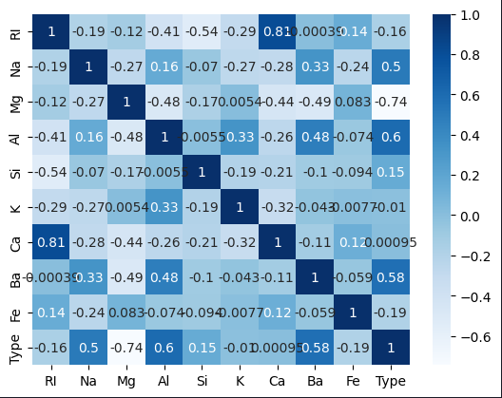
Visualization
Hf
Zr
La
A heatmap is used to visualize data relationships.
Dark Blue: Strong positive correlation (values closer to +1)
Light Blue: Weaker or no significant correlation (values closer to 0)
Ac

Slide 10
Ga
Ge
Sn

Slide 11
Cs
Ba
La
Hf
Ra
Ac
Rf
Db

Slide 12
Cs
Ba
La
Hf
Ra
Ac
Rf
Db

